Slide 1

Art of Computer Programming
for Beginners with Applications to Image Processing
C/C++ Programming Language:
Basics (Character Set, Datatypes, Operators)
Control Statements: To Control the flow of execution
Functions: Avoid rewriting same logic/code again.
Arrays: 1D, 2D, 3D, 4D,…(Arrangement of Similar data types)
Structures, Unions, Classes (Arrangement of Different/Similar data types)
Pointers: Reduces the execution time of the program
Dynamic Memory: (To use the memory effectively),
Files: To get the data from and store the data into.

Slide 3
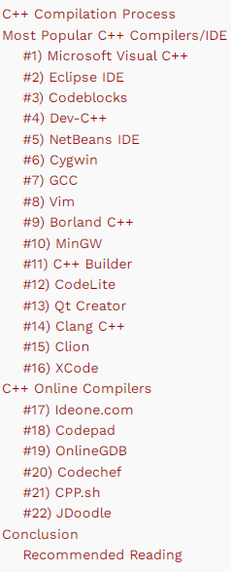
IDE: Integrated Development Environment
An integrated development environment (IDE) is software for building applications that combines common developer tools into a single graphical user interface (GUI).

Slide 4
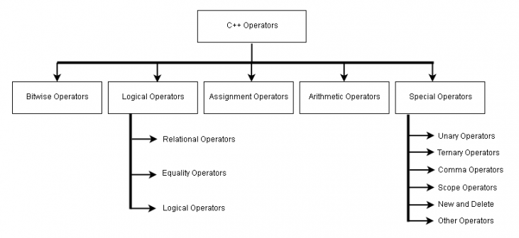
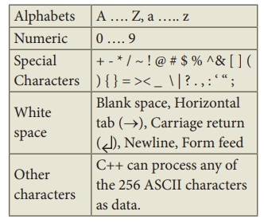
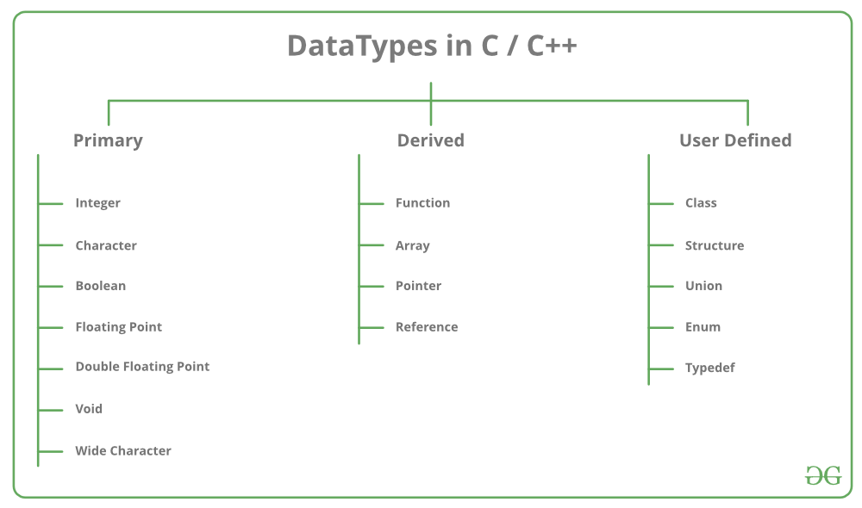
I Basics ( Character Set, Datatypes, Operators)

Slide 5
II Control Statements: To Control the flow of execution

Slide 6
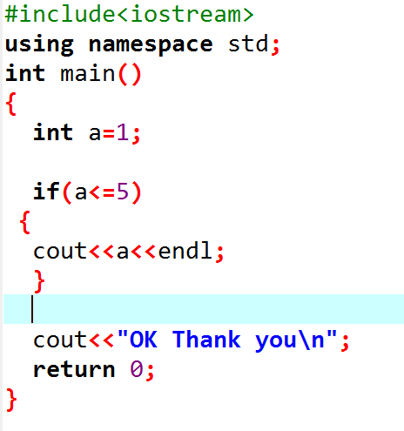

Slide 7
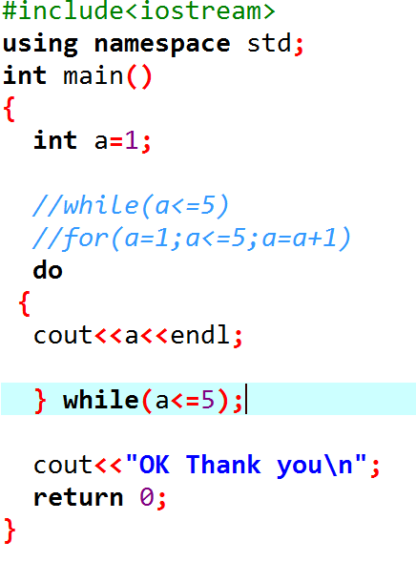

Slide 8
III Functions: Avoid rewriting same logic/code again.

Slide 9
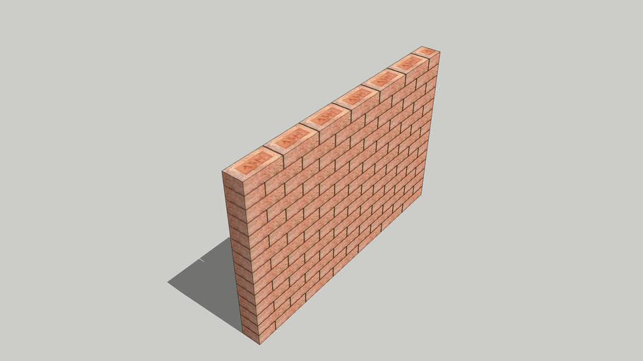

Slide 10
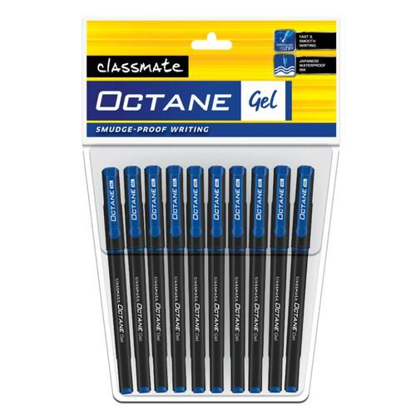
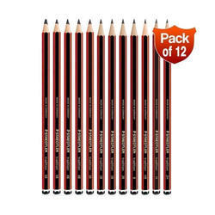
IV Arrays: 1D, 2D, 3D, 4D,…(Arrangement of Similar data types)

Slide 11
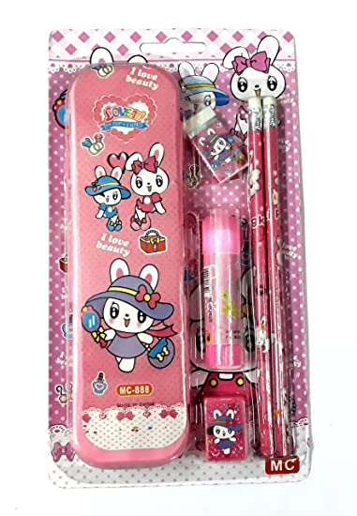
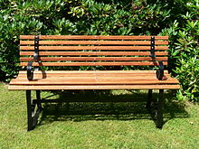
V Structures (Arrangement of Different/ Similar data types)
Raw Material Used are: Wood, Iron Rods, Nails

Slide 12
VI Pointers: Reduces the execution time of the program
Using House Number, instead of House Name
Reduces the execution time of the program.
Pointers provide direct access to memory
It provides a way to return more than one value to the function.
Reduces the storage space and complexity of the program.
Provides an alternative way to access array elements.
It allows us to perform the dynamic memory allocation. And allows us to re-size it too.
Address of objects can be extracted using pointers.
Pointers help us to build complex data structures like linked lists, queues, stacks, trees, graphs etc.

Slide 13
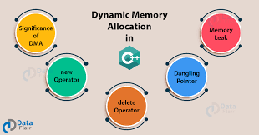
VII Dynamic Memory: (To use the memory effectively),
Before the execution completes we can free the memory, so that OS can use this released memory for some other task.

Slide 14
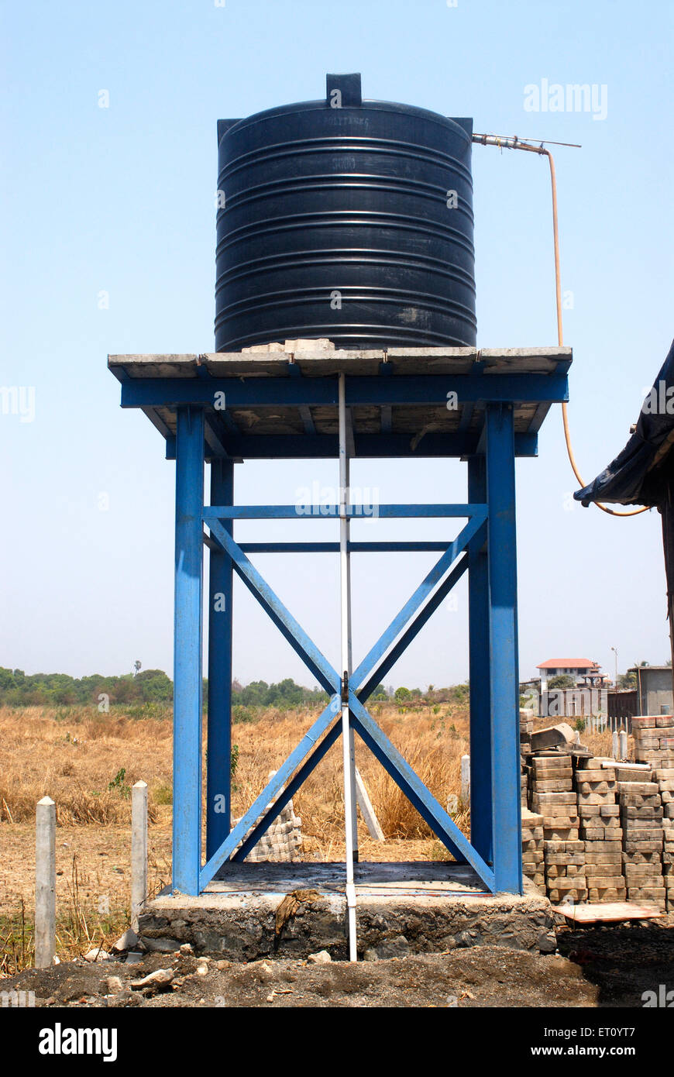
VIII Files: To get the data from and store the data into.

Slide 15
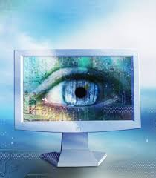
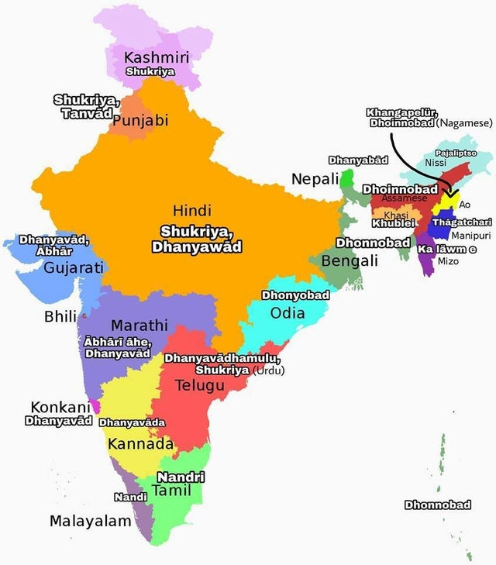
Thank you
Thank you

